Slide 1
CIS 570 Group Project Kahwaji Team 10
Matt Paul Subhashini Venkatachalam Jake Andersen Online Retail Customer Churn
Notes:
Jake
Have everybody introduce themselves

Slide 2
Agenda
Introduction – What is Churn Rate?
Why did we select our dataset?
Analysis
Visualizations
Trends and Takeaways
Questions…
Notes:
Jake

Slide 3

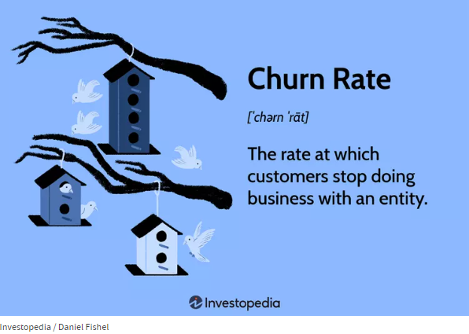
What is Customer Churn?
AKA: Attrition Rate
Most commonly expressed as a percentage
Notes:
Jake
The churn rate measures a company's loss of subscribers for a given period of time.
Churn rates can be applied to subscription-based businesses as well as to the number of employees that leave a firm.
Churn rate is the opposite of growth rate, which measures the acquisition of customers.
For a company to experience growth it must ensure that its new subscriptions are higher than its lost subscriptions in a given period.
Each industry will have a different average churn rate that companies can compare themselves with to understand their competitiveness.

Slide 4
DATA Set Kaggle – online retail customer churn
https://www.kaggle.com/datasets/hassaneskikri/online-retail-customer-churn-dataset
The dataset provides an overview of customer interaction with an online retail store with the goal of predicting customer churn based on various behavioral and demographic features.
Notes:
Jake
https://www.kaggle.com/datasets/hassaneskikri/online-retail-customer-churn-dataset
The dataset provides an overview of customer interaction with an online retail store with the goal of predicting customer churn based on various behavioral and demographic features.
Age, gender, annual income, total spend, years as a customer, number of purchases, average transaction amount, number of returns, number of support contacts, satisfaction score, last purchase days ago, email opt in, promotion response and target churn are all included in the dataset.
We selected this dataset because of its wide range of dimensions. With more options we should be able to get a better picture of customer churn
Additionally, we focused on an online retailer because online retailers have less of a physical interaction with customers that can drive future purchases. Online sales are less personal so we want to try and find traits that can predict customer churn of those customers.

Slide 5

What Dimensions have the largest impact on Customer Churn
Customer churn is costly.
Often less expensive to keep customers then gain new ones
Retaining current customers while gaining new ones is how you increase market share
If we can discover certain demographics that are less likely to lead to churn then the company can put an emphasis on acquiring more customers like that in the future.
Notes:
Jake
We approached Churn from a slightly different direction.
Obviously producing a better product decreases churn
Same with producing goods that are unique or essentials.
However, we wanted to approach this from a different. Are there certain attributes that customers have that make them less likely to churn?
If we can identify these attributes then we can try and find more customers with these attributes.

Slide 6
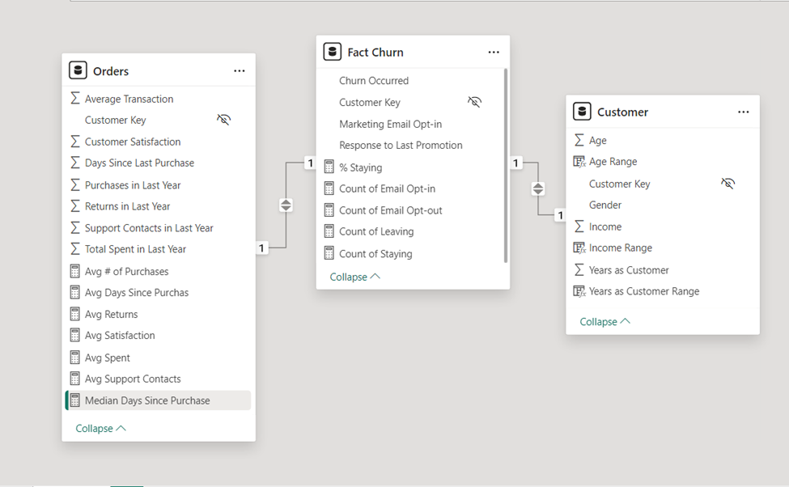
How did we get there?
Notes:
Matt
Downloaded dataset
Uploaded to Power Bi
Used power query to transform the raw data into a fact table (churn) and two dimension tables (customer and orders)
Renamed Data Columns for Clarity
Adjusted income to show full value not a number in thousands
Changed data types for easier analysis
Created Relationships between tables
Created an Income Range, Years as Customer Range, and Age Range column
So we could count the number of people who churned for each range
Our churn data is in true false format. Meaning it says true if the person left. So, I created some measures the count the number of true (leaving) and number of false (staying).
I also produced counts for email responses.

Slide 7
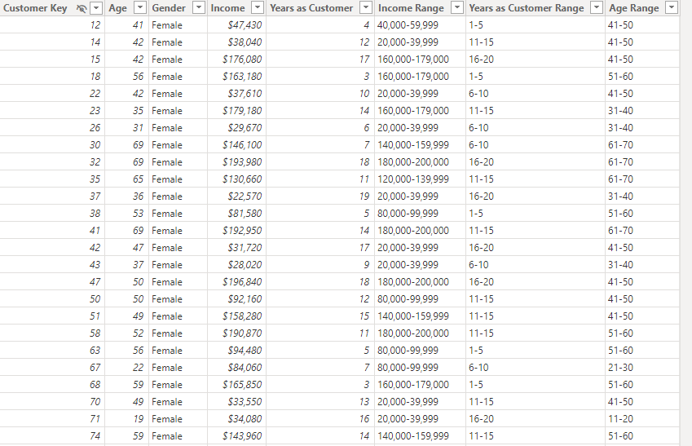
Notes:
Matt
Downloaded dataset
Uploaded to Power Bi
Used power query to transform the raw data into a fact table (churn) and two dimension tables (customer and orders)
Renamed Data Columns for Clarity
Adjusted income to show full value not a number in thousands
Changed data types for easier analysis
Created Relationships between tables
Created an Income Range, Years as Customer Range, and Age Range column
So we could count the number of people who churned for each range
Our churn data is in true false format. Meaning it says true if the person left. So, I created some measures the count the number of true (leaving) and number of false (staying).
I also produced counts for email responses.

Slide 8
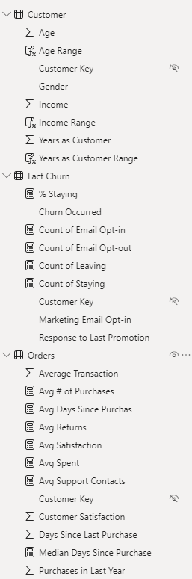

How did we get there?
Notes:
Matt

Slide 9
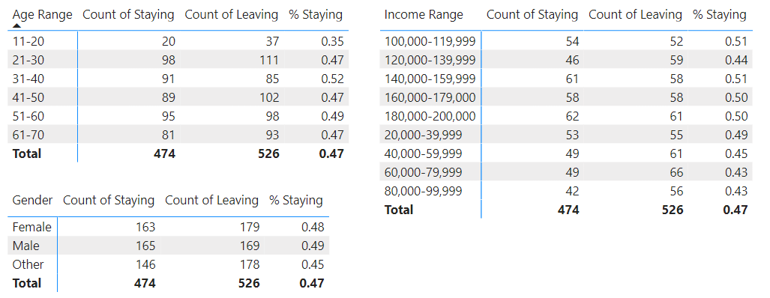
Effects of Customer Dimensions on Churn
Notes:
Subhashini

Slide 10
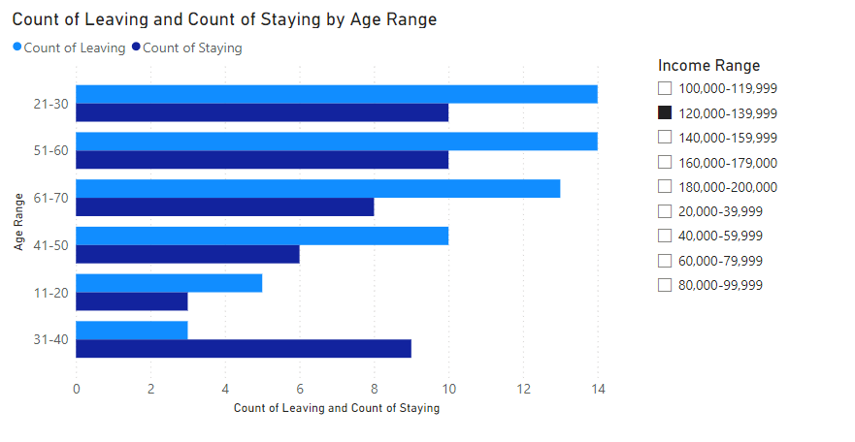
The Effect of Customer Age on Churn
Notes:
Subhashini

Slide 11
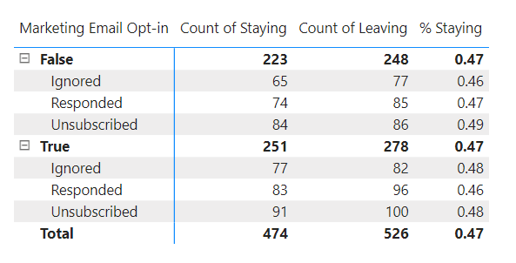
Notes:
Jake

Slide 12
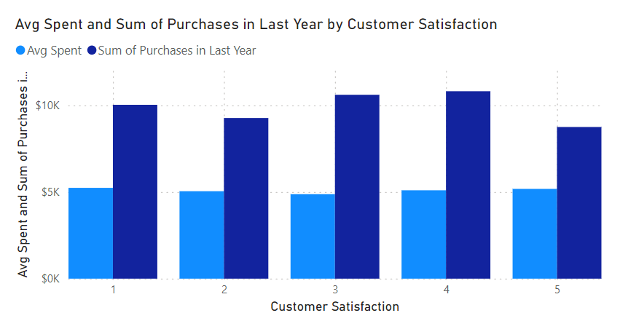
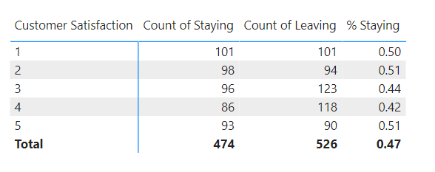
Impact of Customer Satisfaction
Notes:
Matt

Slide 13
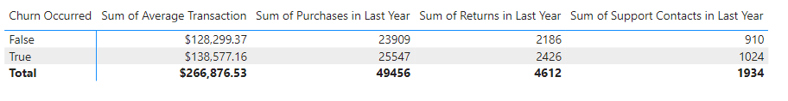
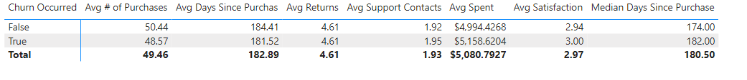
Notes:
Jake

Slide 14
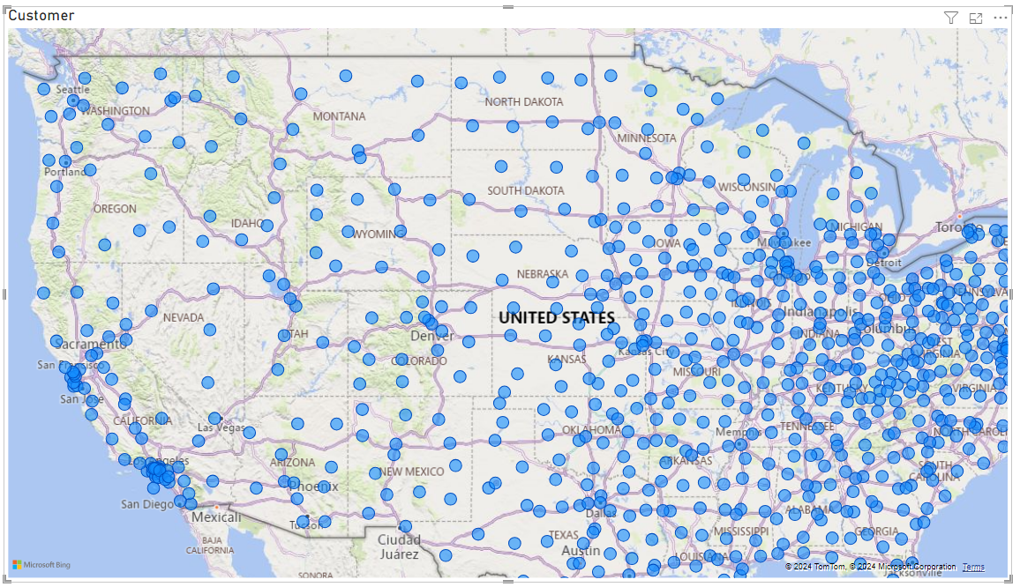
Where are our Customers located?
Notes:
Jake
Its interesting that our dataset was able to provide this information. We are unable to find anything within the dataset that shows a location dimension.

Slide 15
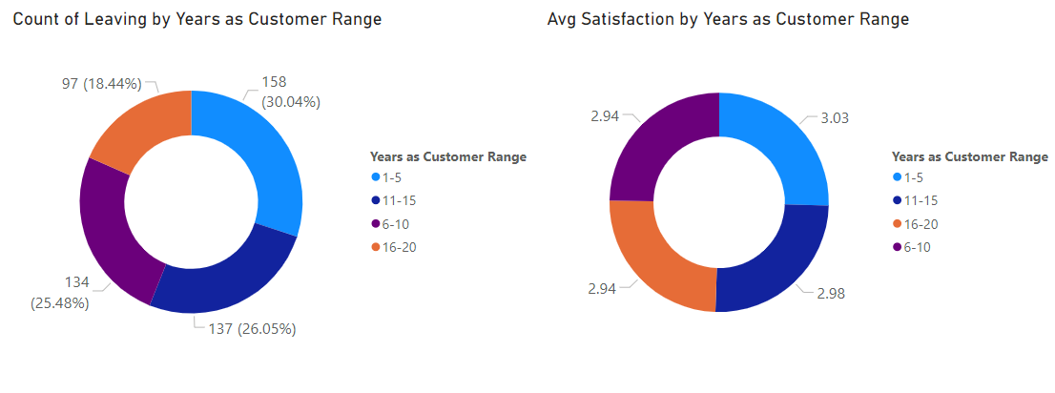
Does years as a customer affect churn?
Notes:
Matt

Slide 16
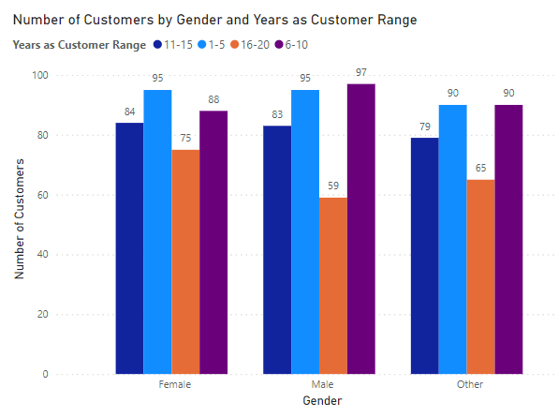
How long have different customers stayed with us? Is there a relationship?
Notes:
Matt

Slide 17
Churn?
Why don’t any of these dimensions have a large impact on churn?
Shouldn’t some of these dimensions affect churn. Like for example shouldn’t people who are signed up on the email mailing list be less likely to churn?
This seems to imply that there is a stronger reason driving churn than demographic info.
People who purchase more products are more likely to churn. Seems backwards from all basic logic.
Explanation is there is something else drawing our customers away
Notes:
Matt

Slide 18
What does it all mean?
Notes:
Jake
Context – we pulled this dataset from online and don’t actually understand the full context of the business or the data. Perhaps its even manufactured and it doesn’t actually relate to anything.
None of our dimensions have a large impact on customer churn. While some dimensions like age can be slightly over the average churn nothing is significantly larger.
This rises the question of why don’t they affect churn? Is there something else more significant that the data isn’t picking up?
Matt
I explored why there was no affect and I found that the customers that are most likely to leave are the ones who spend the most. In addition, they have a higher level of customer satisfaction. This tells me that while the customer has an average satisfaction level with the product of our firm there are other options that are more appealing to the customer.
So new customers that come in rapidly swap over to the other products. More than 60% of our customers have been with the firm for over 10 years. So it seems like once customers are there long enough they become complacent and stick around.
Subhashini
Customer satisfaction isn’t higher with long term customers and I think most likely leaving the firm and finding a new place so purchase products is more work so they just stick around. Churn is 30% for customers who have been purchasing from 1-5 years and it falls to 18% for firms that have been there for 16-20 years.

Slide 19
Thank you
Notes:
All
We look forward to your questions and feedback.

